Slide 1
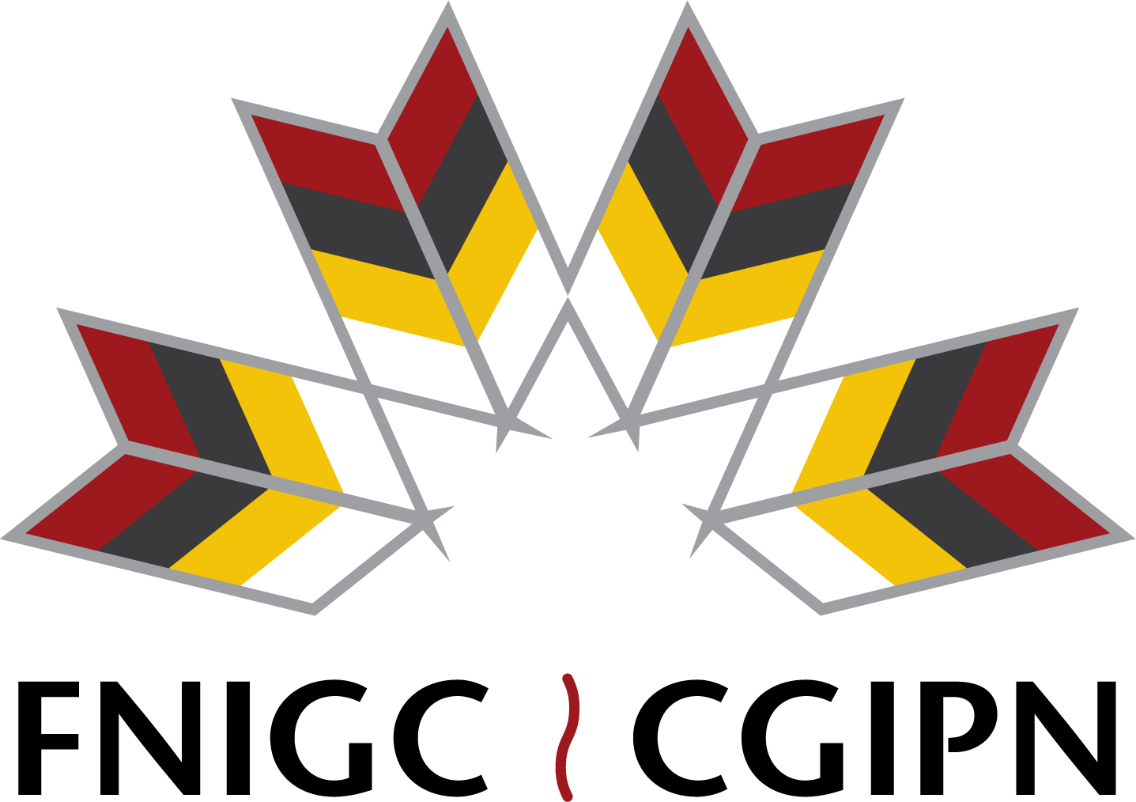

Principles, frameworks, and prompts for action: perspectives on data sovereignty and ‘RDM’
Aaron Franks, PhD
Research Lead, Data Sovereignty Research Collaboraitve
First Nations Information Governance Centre
Opening Doors to Data, CRDCN October 28, 2025
Notes:
I am very happy to be here with you in Treaty One territory and the homeland of the Metis, Quite personal for me to be here with you
Introduce self the Birds, Cromarties, Houries, and Sutherlands. My mother’s fathers family. Took scrip and left St. Andrews for Birch Hills Sask, and eventually Northern Alberta.

Slide 2

About FNIGC
Research
National Surveys
Education, Training, & Capacity
Research on data sovereignty and information governance
Tools and support for here and now, and wayfinding for possible futures
Topical research that aligns with FNIGC priorities
Regional Health Survey (RHS) – ongoing
Early Childhood, Education & Employment Survey (FNREES) – 2016
Labour & Employment Development Survey (FNLED) – present
First Nations data sovereignty
Information governance & management
OCAP®
First Nations Data Governance Strategy (FNDGS)
6
Notes:
Incorporated in 2010
Technical, apolitical not for profit, called for by AFN resolution in 2009.
Comprised of ten regional member organizations
Three broad categories of work – E and T and capacity building, research and the national surveys. The work my team focuses on is in bold.

Slide 3
What is First Nations Data?
Data on Resources & Environment
Data from First Nations
Data About First Nations
Lands, waters, medicines, animals, etc.
Languages, cultures, knowledge, stories, songs, ceremonies
Demographics, housing, health, labour, education, etc.
Notes:
First Nations data is any data about First Nations, from First Nations, and about or derived from First Nations territories, lands and waters
So think about that for a moment.
That’s a lot. It might be better to ask what doesn’t that cover.

Slide 4
First Nations Data Sovereignty
A people’s data and information belong to the people collectively.
First Nations, as self-governing nations and rights holders, have an inherent right to govern their peoples, lands, and resources.
These rights are confirmed in Section 35 of the Canadian Constitution, Section 25 of the Canadian Charter of Human Rights, and the UN Declaration on the Rights of Indigenous Peoples (UNDRIP)
These rights are only realized by the right of a First Nation to exercise authority over its data & information.
First Nations data sovereignty means First Nations data is governed by First Nations laws, protocols, and policies.
Notes:
A people’s data and information are a people’s collective resource
First Nations, as sovereign nations and rights holders, have an inherent right to govern their peoples, lands, and resources.
These rights are confirmed in Section 35 of the Canadian Constitution, Section 25 of the Canadian Charter of Human Rights, and the UN Declaration on the Rights of Indigenous Peoples (UNDRIP)
These rights are operationalized by the right of a First Nation to exercise authority over its data & information.
First Nations data sovereignty means First Nations data is governed by First Nations laws, protocols, and policies.
These laws, protocols, and policies are determined by rights-holding First Nations governments acknowledged by their people.

Slide 5
United Nations Declaration on the Rights of Indigenous People (UNDRIP)
“that [I]ndigenous individuals are entitled without discrimination to all human rights recognized in international law
[I]ndigenous peoples possess collective rights that are indispensable for their existence, well-being and integral development as peoples”.
Notes:
The declaration recognizes and reaffirms “that [I]ndigenous individuals are entitled without discrimination to all human rights recognized in international law, and that [I]ndigenous peoples possess collective rights that are indispensable for their existence, well-being and integral development as peoples”.

Slide 6
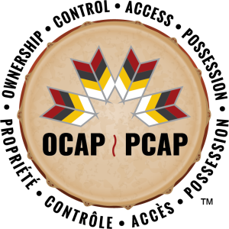

First Nations Principles of OCAP® - a framework for First Nations data governance on the path to data sovereignty
Ownership, Control, Access and Possession
Collection, protection, use, and sharing of First Nations data
Benefits community while minimizing harm
Self-determination, and preservation and development of culture
7
Notes:
The principles were developed by First Nations and allied leaders, health data workers, researchers, and community members – they are owned by all First Nations.
As the national steering committee that developed the OCA and then OCAP acronym became the First Nations Information Governance Centre in 2010, we were entrusted with the stewardship of the principles.

Slide 7
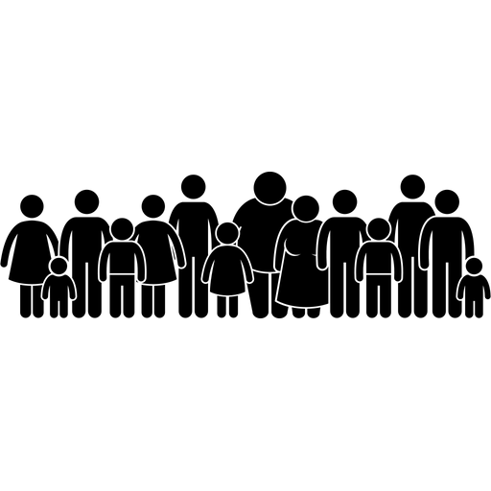
Ownership
Data about First Nations resources, environment
Data from First Nations
Data about First Nations
Notes:
OWNERSHIP:
First Nations are the rightful owners of their data regardless of where the data is housed/held.
In the most fundamental sense, collective ownership over data allows First Nations to take ownership over their own identity, and not allowing others to define who they are.

Slide 8
Control
Use
Collection
Disclosure
First Nation Control
Notes:
CONTROL:
First Nations control what data is collected in their communities, how it is collected and by whom, where it is held, and how it will be disposed of.
A key point to remember is that control extends to all elements of the data collection and management process, whether for research or governance, including setting the agenda, deciding what standards will be used to measure good outcomes, and how and where the data will be preserved.

Slide 9
Access
Limitations of Access
Who has Access
Who does not have access
Conditions of Access
Notes:
ACCESS:
First Nations must have access to their data and information resources no matter where they are located (physically or jurisdictionally) and determine who else can access it and under what circumstances — now and in the future.

Slide 10
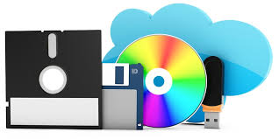
Possession
Data about First Nations resources & environment
Data from First Nations
Data about First Nations
Notes:
POSSESSION:
First Nations must be able to bring any data or information resources collected by them or about them into their jurisdiction, whether by possession within their territory or by exercising their jurisdiction through other means.
Even in the digital era, the bundle of rights and capacities associated with “possession” remain important to realizing data sovereignty.

Slide 11
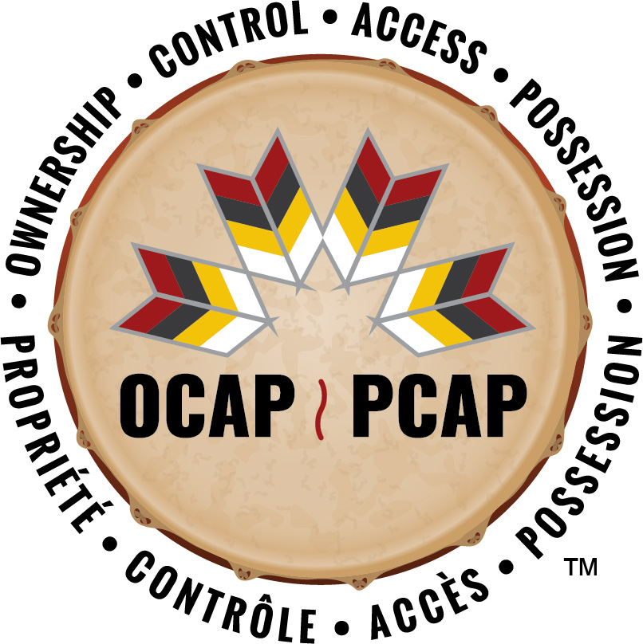
The First Nations Principles of OCAP®
Ownership – First Nations are the rightful owners of their data regardless of where the data is housed/held.
Control – First Nations control all elements of the data collection and management process including what is collected and by whom, and the use, preservation, storage, and disclosure of information.
Access – First Nations must have access to their data and information resources no matter where they are located or which jurisdiction it is under and must determine who else can access it and under what circumstances – now and in the future.
Possession – First Nations must be able to bring any data or information resources collected by them or about them into their jurisdiction, whether by possession within their territory or by exercising their jurisdiction by other means.
Notes:
Other jurisdictions can be in law – like asserting traditional law to protect cultural knowledge and practices. All of this applies to both historical and contemporary data that is in physical or digital form.
Asserting OCAP can happen in different ways, but as we know, principles without tangible examples are not practically useful. We believe that each First Nation should assert OCAP in the ways that make the most sense to them, their unique needs, we keep threads in both how people apply OCAP and how they relate to it. It can be a framework, a tool in your tool box, or anything that you can find useful in asserting your rights along with other relevant frameworks to your community or organization.
Emphasis that there is no certification in OCAP.

Slide 12
the OCAP® Principles are the building blocks for actions (they aren’t actions themselves).
First Nations assert data
sovereignty…

Slide 13
the OCAP® Principles represent commitments (they don’t replace them).
Governments, institutions, and researchers respect First Nations
data sovereignty…

Slide 14
Regional Health Survey (RHS)
Early Childhood, Education & Employment Survey (FNREES)
Labour & Employment Development Survey (FNLED)
First Nations Oral Health Survey
First Nations Community Survey
the OCAP® Principles are practical considerations for First Nations as they build capacity
Notes:
OCAP® was established in 1998 during a meeting of the National Steering Committee (NSC) of the First Nations and Inuit Regional Longitudinal Health Survey, a precursor to the First Nations Regional Health Survey (FNRHS, or RHS). Originally, OCAP® began as “OCA” with the members of the NSC affixing a “P” soon after to acknowledge the importance of First Nations’ people possessing their own data.

Slide 15
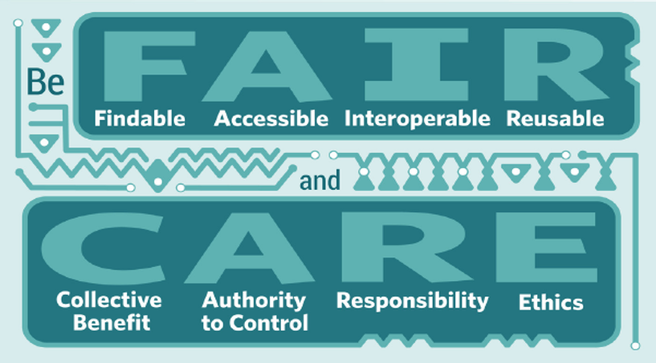
Research Data Alliance principles that serve the ‘research community’
Global Indigenous Data Alliance principles that serve Indigenous peoples
Notes:
Here are the CARE principles in full:
Collective Benefit: Data ecosystems shall be designed and function in ways that enable Indigenous Peoples to derive benefit from the data.
Authority to Control: Indigenous Peoples’ rights and interests in Indigenous data must be recognised and their authority to control such data be empowered.
Responsibility: Those working with Indigenous data have a responsibility to share how those data are used to support Indigenous Peoples’ self determination and collective benefit.
Ethics: Indigenous Peoples’ rights and wellbeing should be the primary concern at all stages of the data life cycle and across the data ecosystem.

Slide 16

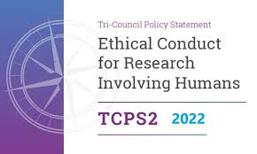

Principles (and guidelines, and standards) are prompts to action

Slide 17
Indigenous Peoples and Academic Research System- RDM
First Nations
REBs
Commercialization and Intellectual Property (IP)
Research Data Management
Grants and research funding
Staff and student training and education
Student and administrative data
Lands and waters, territory
Animals, medicines, all our relations
Notes:
At universities and research institutions there are also Intellectual Property, commercialization, funding, and other policies related to research that cross many legal, ethical, and First Nations jurisdictional lines.
This is on top of other functions of research institutions, like education and maintaining administrative data, which come with their own information governance and data sovereignty challenges and opportunities.
Imagine the structural and epistemological challenges First Nations face when forced to assert control over their collective information resources in each of these often siloed contexts.

Slide 18
Research Data Management
Research data management (RDM) is the active planning and organization of research data throughout the entirety of its lifecycle. This lifecycle includes the policies, protocols, and practices related to data collection:
analysis and interpretation;
storage and security;
sharing;
withdrawal and disposal; and
return of results to participants and dissemination of results to the broader public.
Notes:
Before we discuss research data, and research data management, let’s expand on what constitutes data. Data as a concept can be confusing, especially since we do not want to further the datafication traditional knowledge. However, when data is defined as facts, measurements, recordings, records, or observations collected by researchers and others, with a minimum of contextual interpretation. And that data may be in any format or medium such as text, numbers, symbols, images, and films, it might encompass traditional knowledge. This means, that these items should be protected with unique considerations in the research data management process. Research data is the data that collected from research materials such as data that describes an animal’s behaviour under certain conditions, or an analysis of the ideas captured within archival documents – not just the documents themselves, which would be classified as research materials. Research Materials are the objects of study such as a human or ecological bio-sample, documents from an archive, or a run of salmon. Managing this data across a research project can be challenging depending on the situations. In the bigger picture, the creation of “data” from “research materials” always involves the removal of vital context from that information. That is why we are exploring the needs of First Nations through the complexities of research data management to better understand what lessons and tools communities and governments can use to protect their data.
[read slide points]
From a data use perspective effective Research Data Management ensures that data remains usable and accessible over its lifecycle. Research Data Management is concerned with research data including both physical and digital data. However, there is more focus on the digital because contemporary Research Data Management requires the use of digital research infrastructure to track and manage data and some research materials even if the data is itself not digitized. From a data governance perspective, effective Research Data Management ensures that data is being handled in a way that is compliant with the applicable laws and policies, which we will get into next.

Slide 19

SSHRC-funded project: "Asserting and Respecting First Nations Data Sovereignty in Research Data Management"
First Nation and Inuit Community Partners | Academic Institutional Partners
Chippewas of the Thames FN | Canadore College
Kahnawá:ke Education Centre | McGill University
Mississaugas of the Credit FN | Memorial University
Nunatsiavut Government | The University of Guelph
 | The University of Ottawa
 | Western University
Building Relationships and exploring assumptions
Digging into the elements and issues of RDM
Identifying concrete steps to action
Four Virtual Dialogues from September to January 2024
Notes:
RDM is an important subject because it is about the entire lifecycle of data, and if we make the choice – can include particular attention to long-term – intergenerational, perhaps indefinite – governance and care of data.
Some First Nations may want to work with universities and colleges – but want to do it in a way that benefits them, increases their own capacity to care for and benefit from their own data, and advances their self-governance and data sovereignty.
With a small grant from the SSHRC Connections program, we hosted four dialogues over 8 to 9 months last year, to promote respectful critique and frank reflection on current research institution practices, and the opportunities for constructive visioning of First Nations and Nunatsiavut communities’ aspirations and needs for their own data governance and sovereignty.
The goals we set for ourselves at the outset were:
Build stronger relations between First Nations and Nunatsiavut and local universities and colleges. The main focus was clarity on expectations and transparency on how research institutions work.
Learn about how institutions are thinking about and approaching issues of Indigenous data sovereignty.
Deepen understanding of Indigenous data sovereignty (IDS) within the context of research data management (RDM) in general.
Identify ways for universities and colleges to respect First Nations and Nunatsiavut data sovereignty and the principles of OCAP® in research data management in line with each First Nation’s vision and worldview.

Slide 20
What participants told us
Communication and Understanding:
Communication must continue throughout the lifecycle of data;
Relationships and rights need to be clearly defined and respected;
Growing number of institutionally based researchers feel their obligations to data sovereignty rights of Indigenous people, but feel unsupported and not incentivized by institutional and disciplinary norms, expectations, and structures;
Relying on government and institutionally prescribed colonial data management practices doesn’t align with different cultural views on data ownership and privacy;

Slide 21
What participants told us
Capacity: ability to understand - and act
There are significant capacity issues across both community and institutional infrastructure;
Community and Institutional capacity both need to grow to support ethical RDM if
partnerships are to work for First Nations;
Research Institutions need more flexible policies and processes;
Building capacity in single communities alone is not building “community capacity”. Indigenous Nations and relationships expand beyond individual community borders.

Slide 22
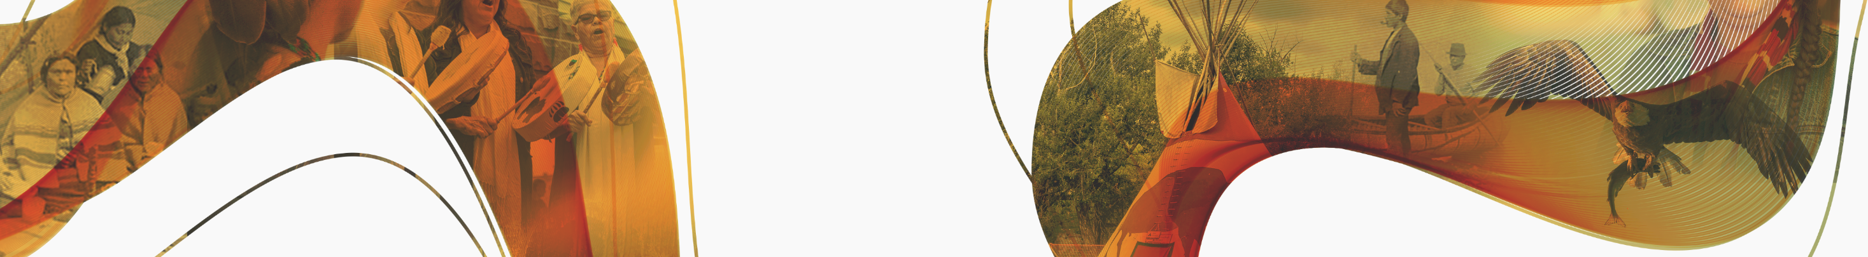
RDM is MDR
Institutional Research Data Management: data remains usable and accessible over its lifecycle - to researchers
Communities Making Data in Relation: data is created and cared for with continuous consideration for community context
Notes:
We call it Research Data Management is Making Data in Relation, or RDM is MDR.
from a researcher’s data use perspective, effective Research Data Management ensures that data remains usable and accessible over its lifecycle.
So when research institutions talk about Research Data Management, they mean that data remains usable and accessible over its lifecycle – to the researchers and potentially thousands of other researchers.
If we begin with an MDR framework, Making Data in Relation: data is created and cared for with continuous consideration for community context

Slide 23
Community Data Ownership and 3rd party Data Stewardship
Data Stewardship
Data Ownership
“FNIGC assumes responsibility only for the copy of anonymized data shared with it by the Organization, and only for the duration and purposes detailed below. The Organization will retain the original data collected from their community members and will be responsible for its care and governance.”
“The Organization retains full and sole ownership of the data they collect and any data collected from them by FNIGC for the purposes of this project. [Federal agency] has no rights to the data, and FNIGC is provided with permission to use the anonymized data for the project as set out below. It is understood that the Organization may use their own data in whatever manner they wish, in accordance with whatever obligations they have outlined with their own members and/or project participants and [Federal agency]”
Notes:
Example of simple change in agreement between two parties – FNIGC and a federal agency

Slide 24
Examples of how we use OCAP in our work
Saying what we mean
Avoiding ‘legalese’ where possible
First Nations Ownership
Specifying that any data created by First Nations organizations is owned by them
Clear research data management
We specify how the data will be stored and what security measures are in place
Specifying that First Nations organizations who created and provided the data will be given opportunities to comment on and view the analysis
Sufficient explanations and context
How data will be used
What the measures are after the project is complete
Ensuring we can stick to our principles when we are working with research institutions or the Canadian Government – especially if we are using words, knowledge, and information created by First Nations people or organizations.
Notes:
When we talk about putting the OCAP principles into practise, we can use the example of how we approach data sharing agreements where we are entrusted as data stewards and ensuring contract language respected OCAP for First Nations organizations who provided collected data to the project. Recently, we worked on a project with a department of the federal government in partnership with different Indigenous organizations that serve First Nations, Inuit, and Metis people and communities. The department collected data from them for us to research, analyse, and prepare into a report. When creating our data stewardship agreement we specified that the agreement would be put into plain terms wherever possible, shifting language from terms like “to licence” to “give permission.” We were able to do this in contextual sections of the agreement, the more binding policy sections of the agreement, we had to leave in standard legal language to protect the organizations and their data in the Canadian legal tradition – this is not ideal, but it is what we must work within.
Additionally, when the data sharing agreement was shared with the government department they had some confusion about the ownership of data. It is the common institutional understanding that if they provide the funds for a data collection that they then own that data and can use it for whatever research projects they need without sharing back the collected information. Under FNIGC’s data stewardship agreement, the team refused to steward the data if it was not specified in the agreement that the Indigenous organizations that contributed the data owned the data. FNIGC also noted how many times in the process these organizations would get to see the progress of the project and to comment on how the data was used in the analysis – so that they are not misrepresented.
Finally, another aspect of this data stewardship agreement that asserts, respects, and affirms the OCAP principles is a clear research data management plan. This includes informing the Indigenous organizations who own the data how we are going to store their data, what security measures are in place, that FNIGC is not allowed to use this data for secondary purposes, how long we will have access to the data, and then what happens after that term is up. In this specific project example, we noted that all original data, anonymized, and analysed data would be returned to them and our copies would be destroyed. FNIGC specified that the only kept item would be the final report that would be delivered to the organizations and the funder. We also made it clear that this final report could be made public, but that they would have authority to comment on this work before submission so it could be changed to better reflect the organization’s meaning and keep accountable to those who created the data.

Slide 25

Principles (and guidelines, and standards) are prompts to action
One of the most significant additions to the CARE principles in the SODA framework is the explicit recognition of ownership…This addition reflects a deeper commitment to respecting and protecting Sámi data sovereignty. (Rune Fjellhiem, 2024)
“RDM is MDR”
Thank you. Aaron Franks @ afranks@fnigc.ca

